Slide 1
The Dewint House
By Areana Delaosa

Slide 2
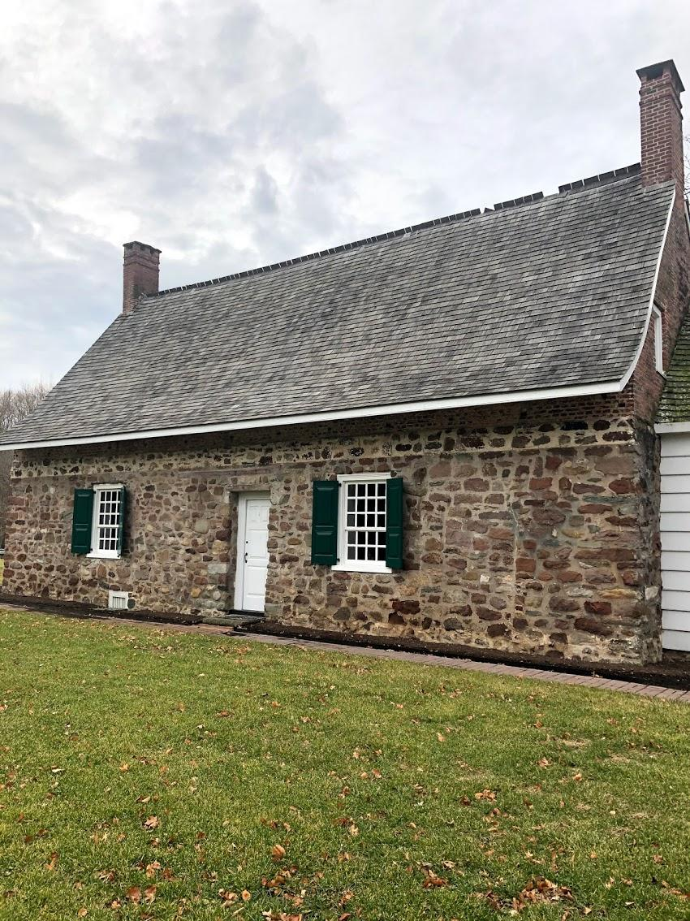
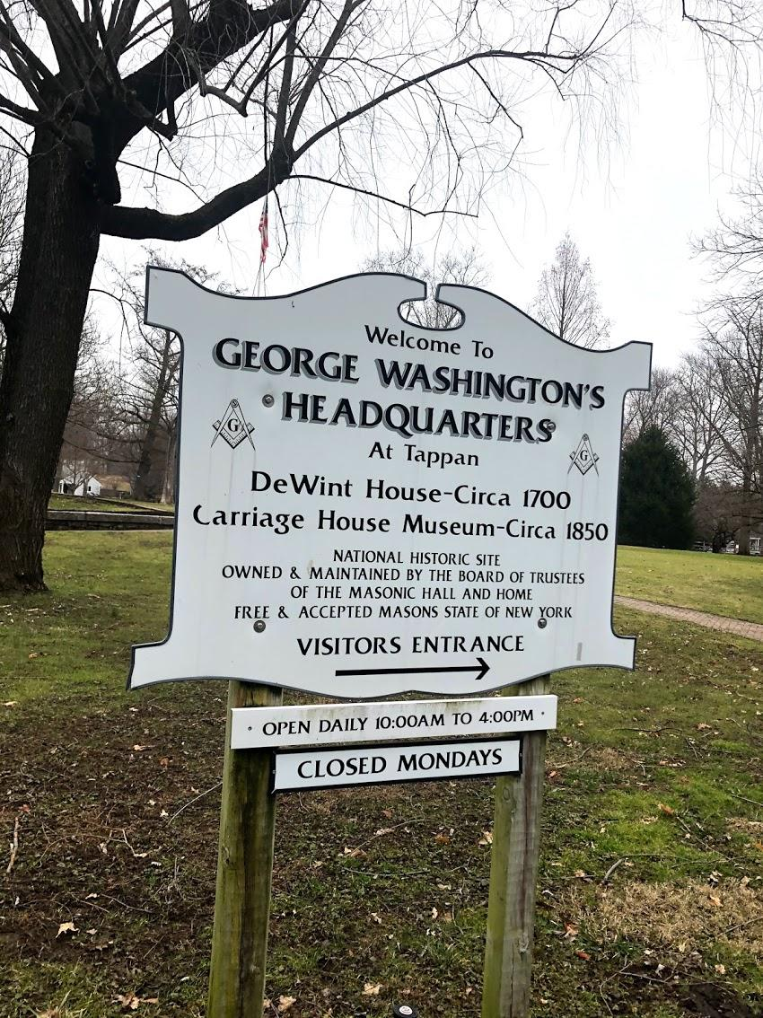
-It’s known as the DeWint House, after the family who owned it during Washington’s visits.
- It is the oldest surviving structure in Rockland County, New York,
-Washington’s first stay at the House was from August 8 to 24, 1780, while he was inspecting a redoubt on the Hudson.
-Major Frederick S Blauvelt, the son-in-law of Johannes and Antje DeWint, who owned the house at the time, invited Washington to stay with the family.
-Later, when the American Army had moved to Orangeburg, Washington returned on September 28, through October 7, 1780, for the trial and subsequent hanging of the British spy, Major John André. André had been captured after a meeting with American General, Benedict Arnold, at which they made plans to betray the fortifications at West Point.

Slide 3
Three years later – May 4 through 8, 1783 – while negotiating the final withdrawal of British troops from New York City with British General, Sir Guy Carleton, Washington and his key staff again headquartered at the Dewint House. Samuel Fraunces (owner of Fraunces Tavern in New York City) came up to prepare the dinner Washington hosted for the British General.
That winter (November 11-14, 1783) on his trip to visit West Point, and later to New York City where he tendered his resignation, Washington was forced to stay again at the DeWint house during a terrible snowstorm. During the War he had forbidden his soldiers to play cards because it took time away from the pursuit of the war. Now, with the fighting over, a much more relaxed Washington took off his boots and played cards.
As new families occupied the house, changes were made to the basic structure. After DeClark’s death in 1731, the house remained in his family for several years and then was sold to Rem Remsen of Brooklyn. The DeWint family, from the West Indies, owned the house from 1746 to 1795, which covers the period when Washington visited.

Slide 4
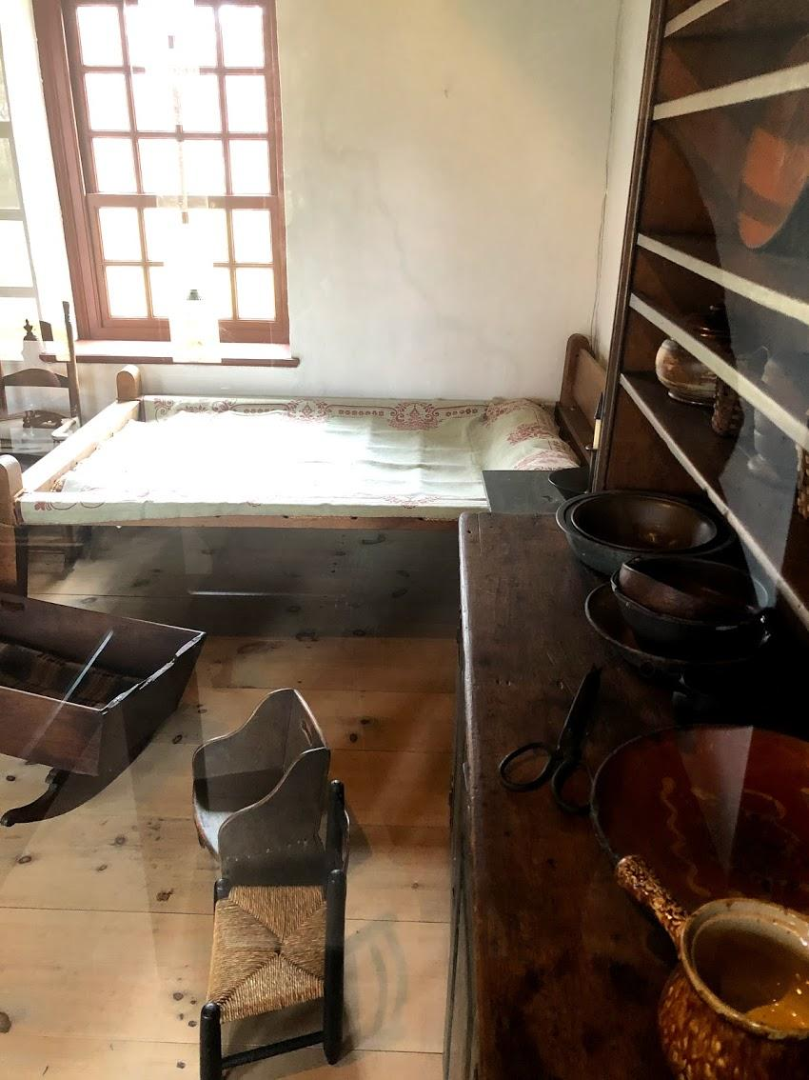
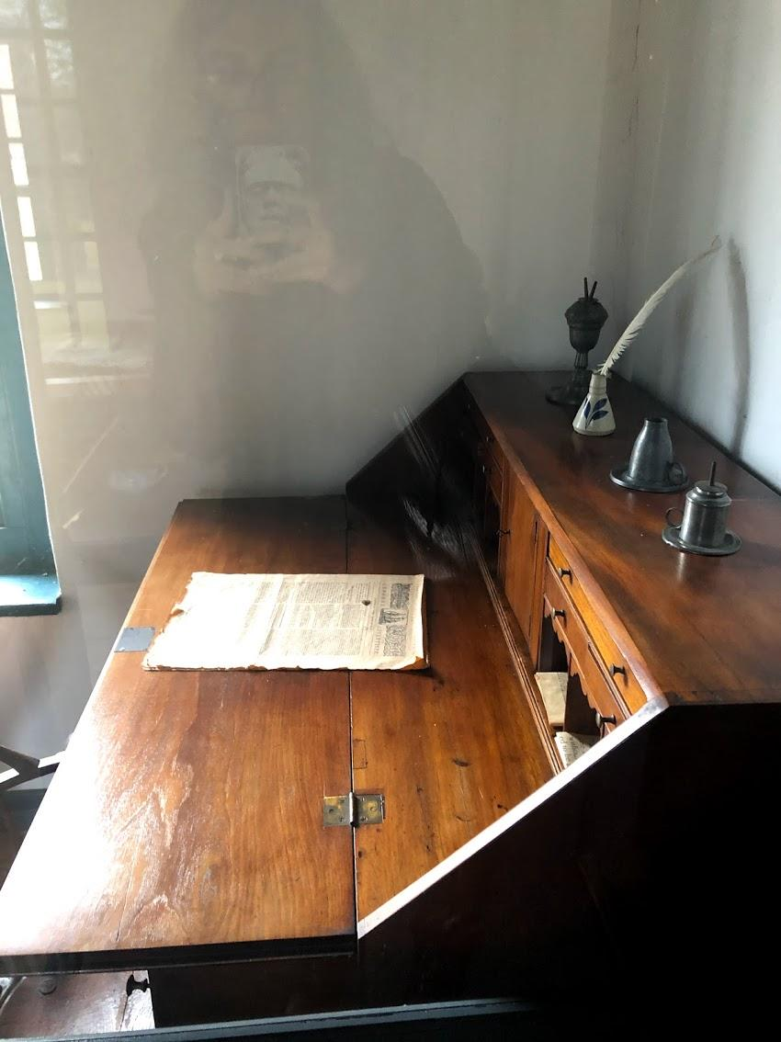
Original furniture when George Washington stayed at De Wit House.
Here there’s a bed and a desk with a newspaper that was left in the drawer when he stayed 1746-1795.

Slide 5
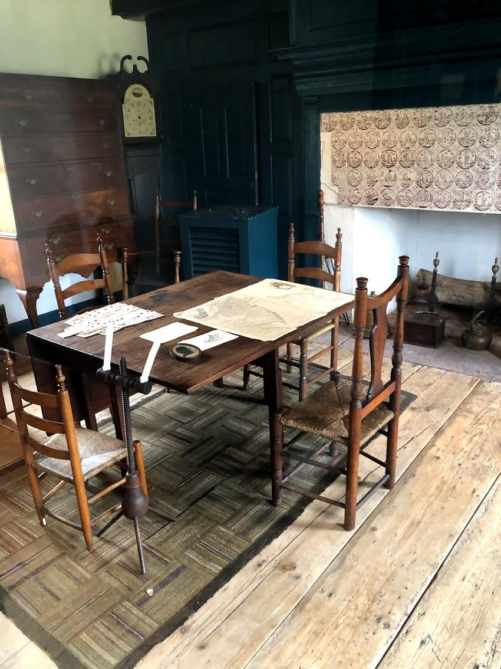
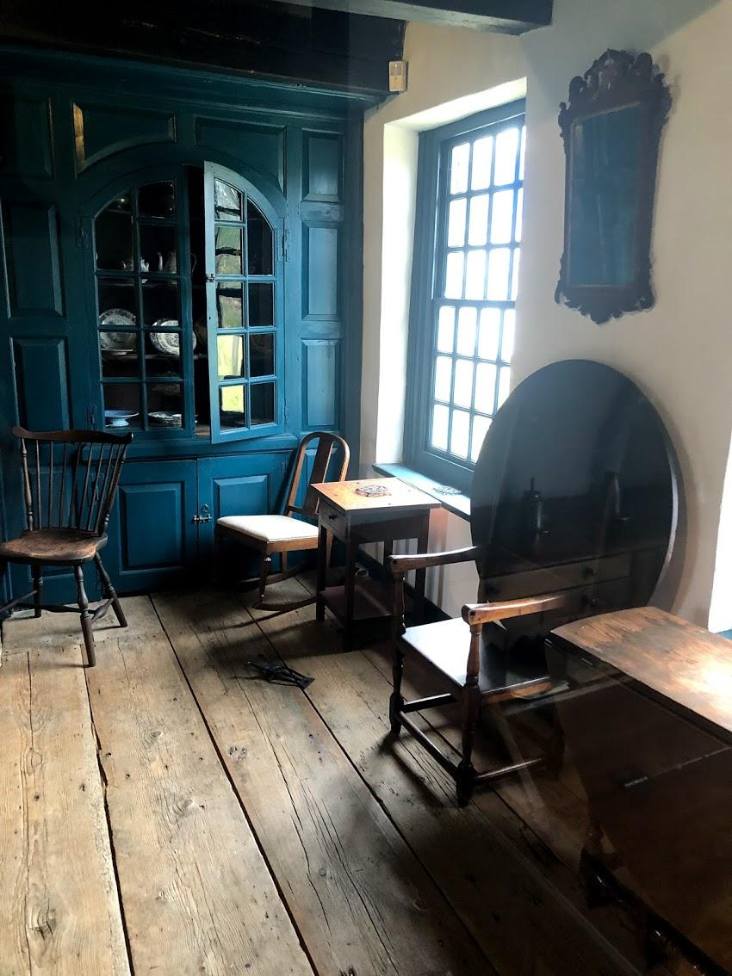
This is where Washington and soldiers played cards and he was able to relax during the snowstorm.It took time away from the War.

Slide 6
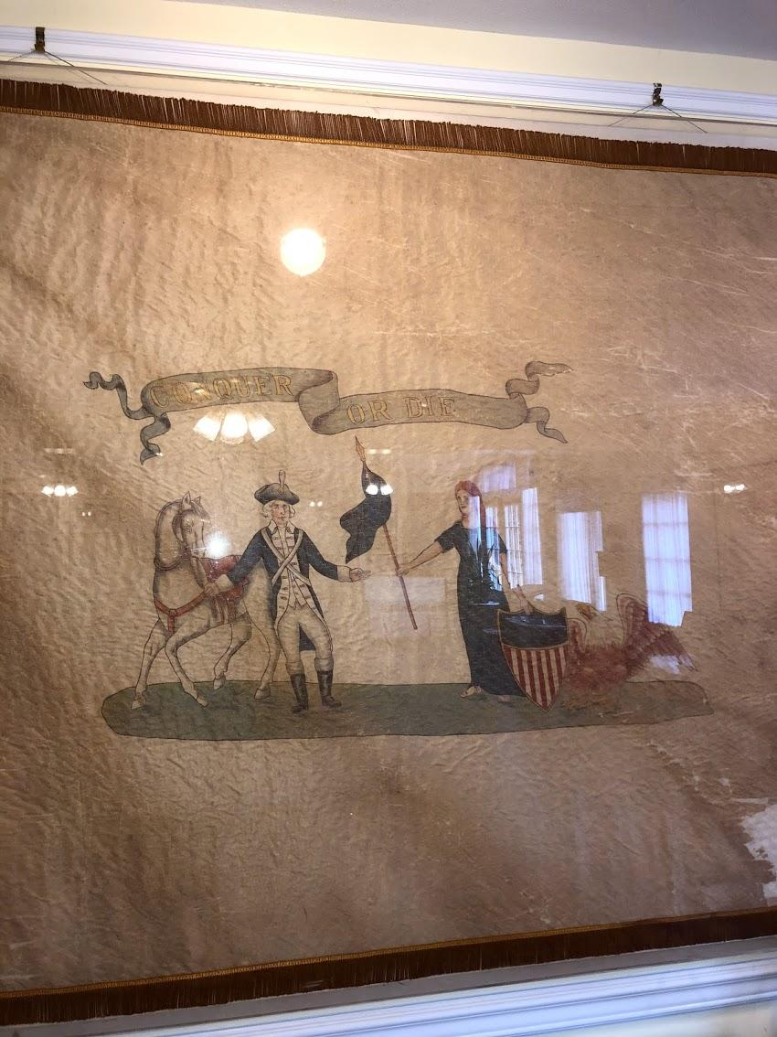
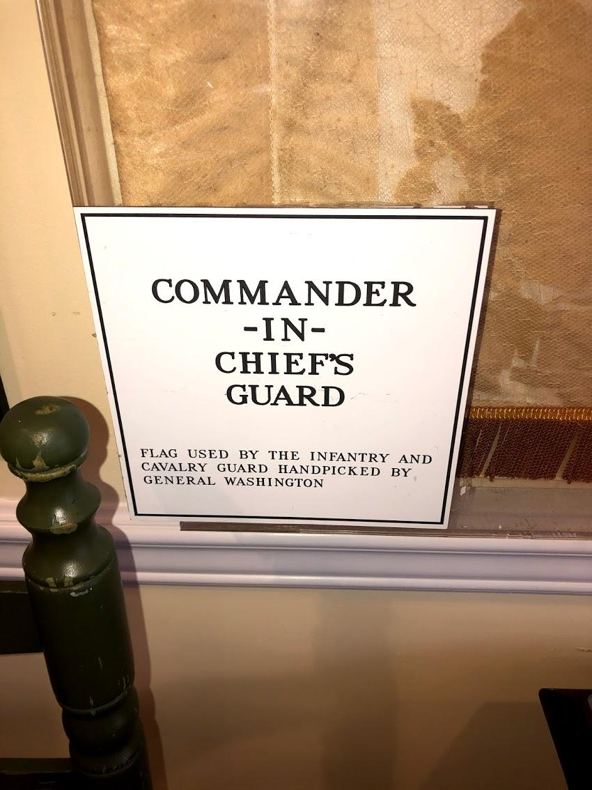
-George Washington was born into February 22,1732 into a Virginia planter family, he learned moral and manners
-Well known as the first president of the United states,won 3 out of 9 battles
-He pursued two intertwined interests:military arts and western expansion
-When the french revolution broke out under Washington’s presidency he was faced with a serious turning point.
-Very famously Washington took the middle ground and refused to back either side in their war.

Slide 7
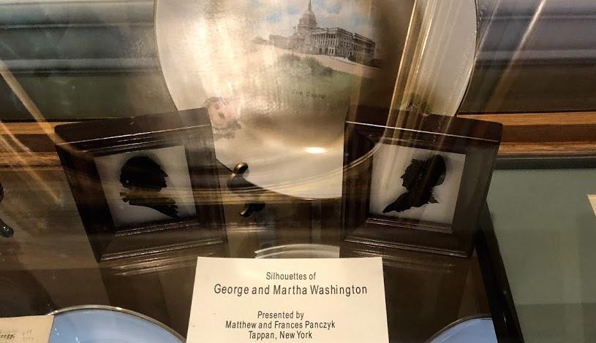
-George and Martha get married January 6, 1759.
-Martha already had two from her previous husband who passed away. Martha Patsy Custis and John Custis. -They had no children together and George raised Martha's children and loved them like they were his own. -George Washington outlived both his step children
-Patsy died from a health condition called epilepsy since she was 16 and John died of what was known as ‘camp fever’ or meningitis.
-John had two sons from his marriage, Eleanor Parke Custis and George Washington Parke Custis. The Washingtons brought up these children besides taking care of the both the families of Dandridge's and Washington's.
-During George Washington’s Presidency, it was Eleanor Parke Custis, his step granddaughter, who used to entertain the guests at the New York City’s presidential mansions, and at Philadelphia and at Mount Vernon. In 1799, she married George Washington’s nephew.
These are Silhouettes of George and Martha Washington. This was a popular way to portrait yourself and a loved one in the late 1700’s-1800’s. This was Presented by Matthew and Frances Panczyk
Tappan,NY

Slide 8
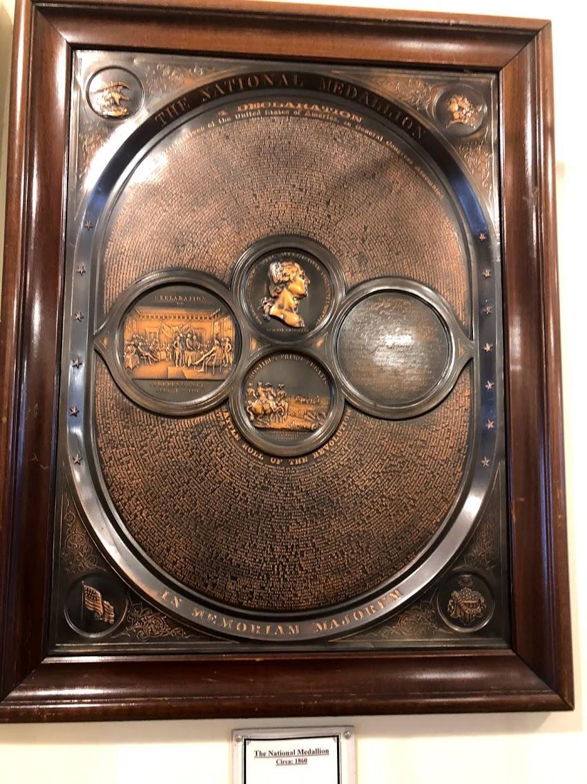
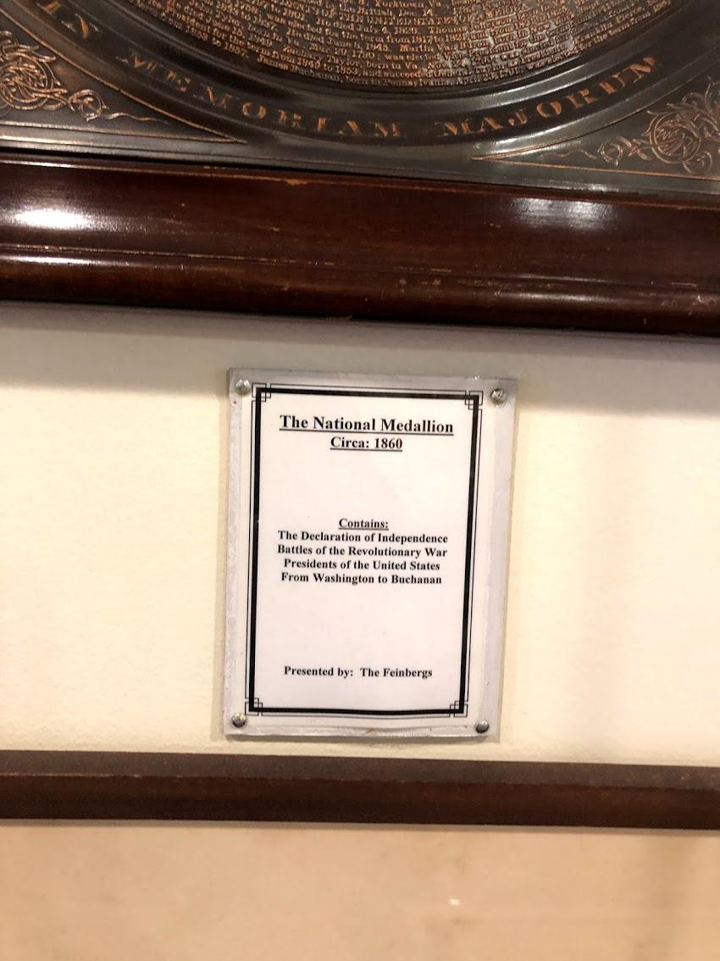

Slide 9
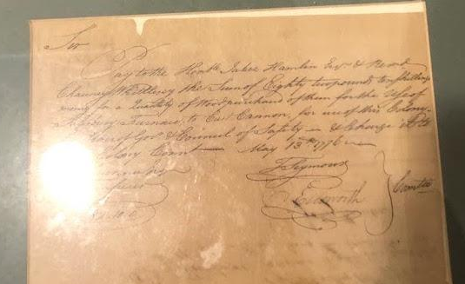
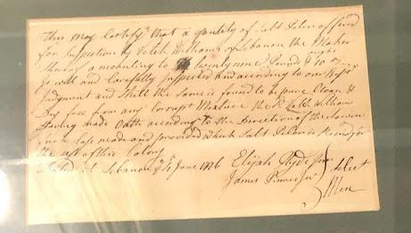
America is ready for war 1776
These are two authentic documents from the American Revolutionary period: The first one is a pay voucher for SALTPETER,the main ingredient in gunpowder, which is being purchased by the colony of Pennsylvania.
The document below is a pay voucher for wood to fuel the Salisbury Furnace in Connecticut.The furnace was used to cast cannon and other materials in the war effort.

Slide 10
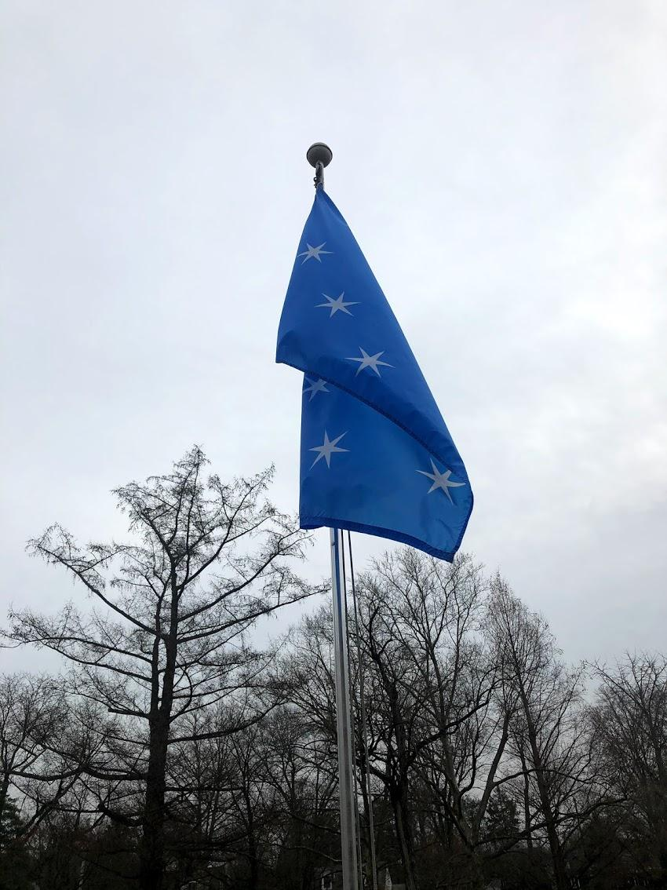
Washington flag,1775.
This is a reproduction of the personal flag used by General Washington as commander and chief during the Revolutionary War in 1775.The presence of the flag represented that George Washington was there during a battle.He personalized it himself.

Slide 11
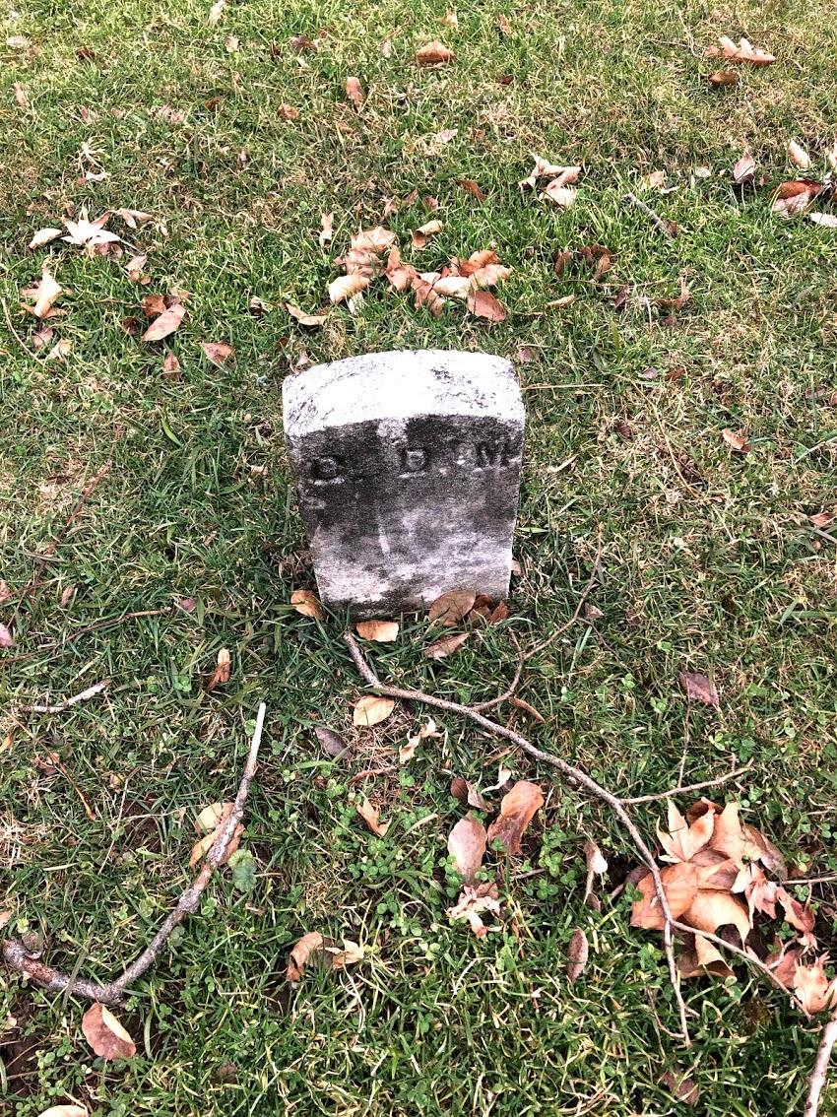
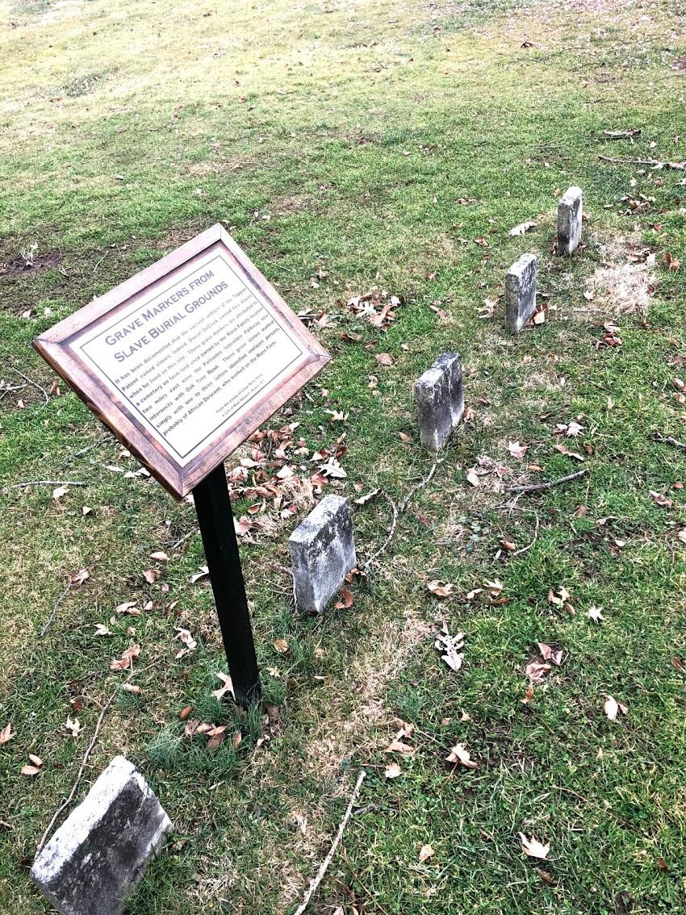
Grave Markers from slave burial grounds
It has been documented that the earliest settlers of the tappan patent owned slaves;indeed. Daniel DeClark owned two slaves when he lives on this site ( owners after the Dewints).These grave markers are attributed to a cemetery on farm land once owned by the Mann faculty located two miles east were the palisades interstate parkway now intersects with Oak Tree Road. These gravestones marked simply with one to three letters identified enslaved persons,probably of African Descent,worked on the Mann farm.From the estate of Lillian Rose Perry. Nyack NY.

